Slide 1
INCORPORATING STEM CONCEPTS INTO STORIES: CONTENT-BASED INSTRUCTION
Integrated STEM Education with an Interactive Digital Library for Curious Kids-CURIKIDS
25-29 September 2023 – 1st Learning Teaching Training (LTT) Activity
Akdeniz University, Antalya, TÜRKİYE
Dr. Funda ÖLMEZ ÇAĞLAR

Slide 2
EXAMPLE TEXTS TO TEACH
Including a story based on a STEM concept to a CBI lesson.

Slide 3
EXAMPLE TEXTS TO TEACH
How stories involving STEM concepts can make a difference on lessons
e.g. a lesson plan that is based on content-based instruction (Elliot, n.d.)
Topic: the life cycle of a flowering plant

Slide 4
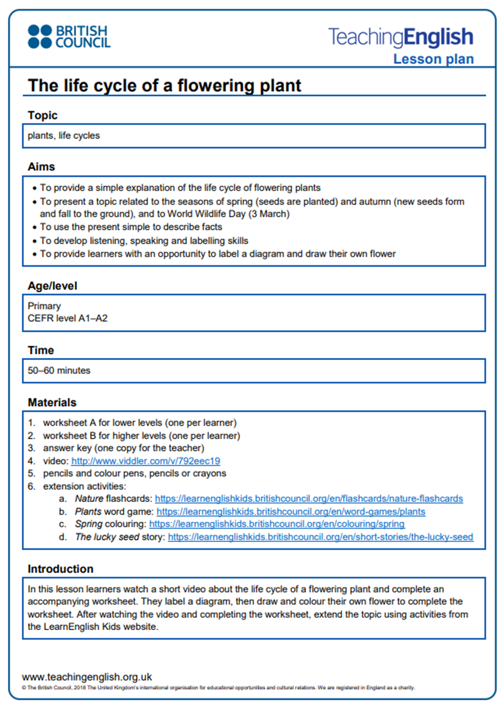
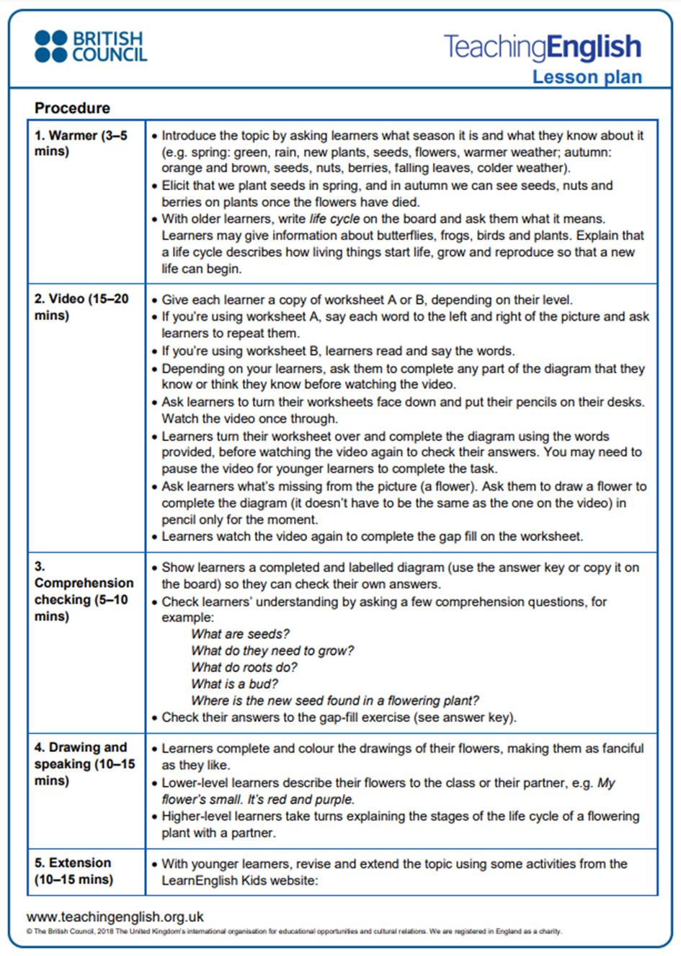

Slide 5
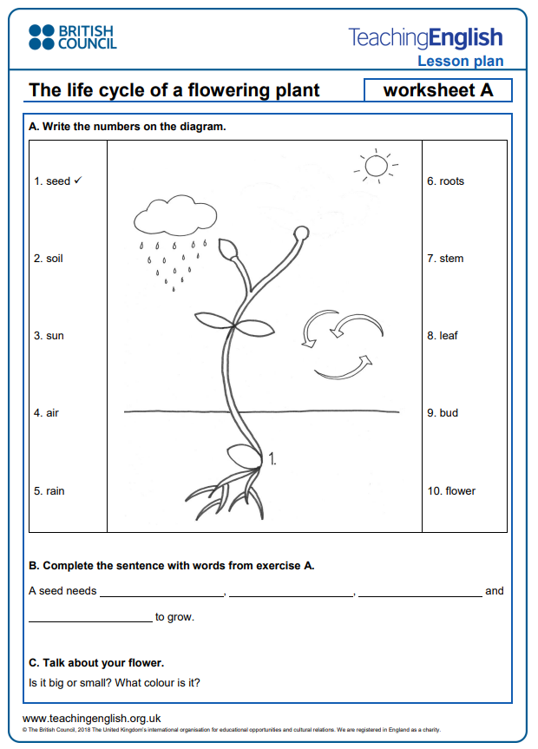
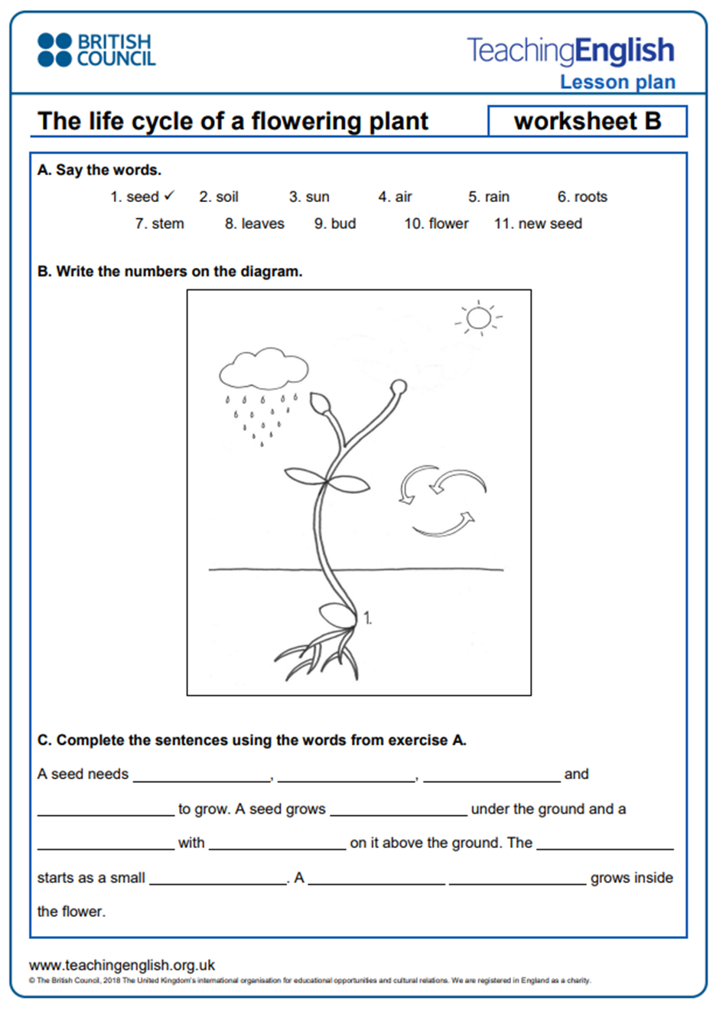

Slide 6
IN SHORT,
The lesson plan involves
various activities about the topic that aim to develop language skills.
However, including a story in which the STEM topic (the life cycle of a flowering plant) is integrated
can make the learning process more meaningful and permanent for the learners.

Slide 7
FOR INSTANCE,
to raise students’ awareness of the life cycle of plant or tree and
to help them improve their language skills at the same time,
the story “The Lucky Seed” (Ashmore, n.d.) can be used:

Slide 8
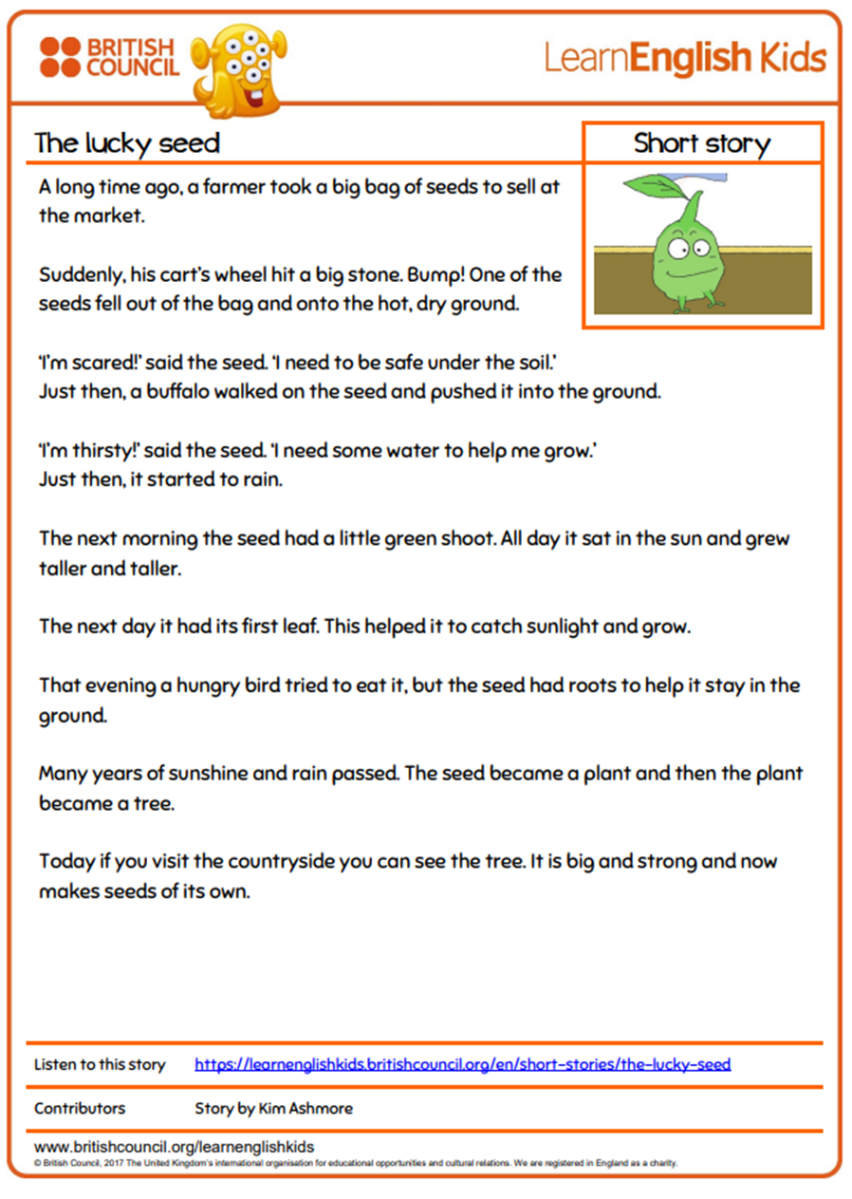

Slide 9
LET’S PREPARE A LESSON PLAN

Slide 10
SAMPLE ACTIVITIES

Slide 11
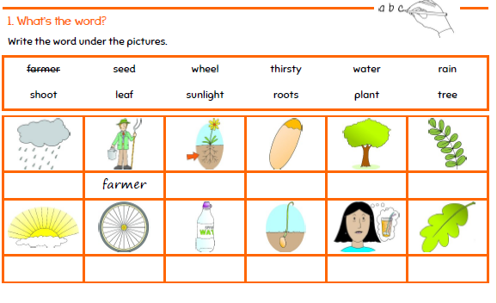
PRE-READING

Slide 12
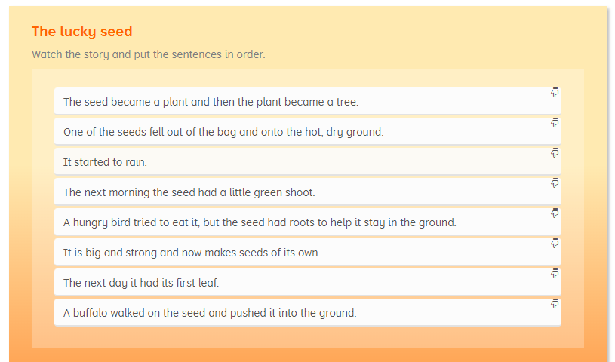
POST-READING

Slide 13
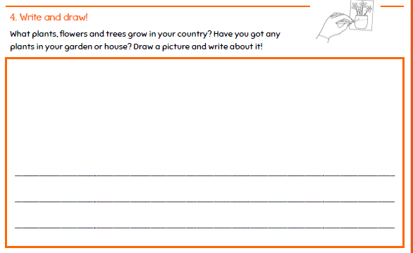
POST-READING

Slide 14
Ordering the pictures/stages

Slide 15
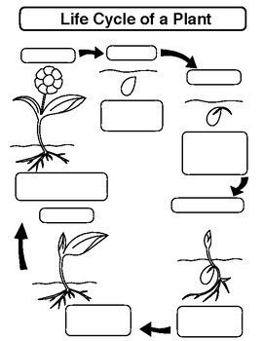
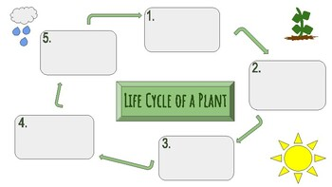
Using graphic organizers

Slide 16
How about creating a story using AI?

Slide 17
CONCLUSION (1/2)
When supported with effective and creative activities, stories involving STEM concepts can:
make those subjects more relatable, fun and meaningful for Ss
offer a narrative background and meaningful context for STEM topics.
provide a contextualized learning experience
help Ss to comprehend the topics more easily and remember them in a contextualized form
reinforce language development especially when accompanied with well-structured activities and tasks

Slide 18
CONCLUSION (2/2)
STEM topics incorporated into stories can
arouse curiosity for further learning.
help to work on problem-solving skills (when initiated by themes)
help to work on critical thinking skills,
help Ss to adopt a positive attitude towards STEM concepts while improving language skills at the same time

