Slide 1
Storytelling for stem education
Emine ŞENTÜRK
Department of English Language and Literature
Akdeniz University, 2023

Slide 2
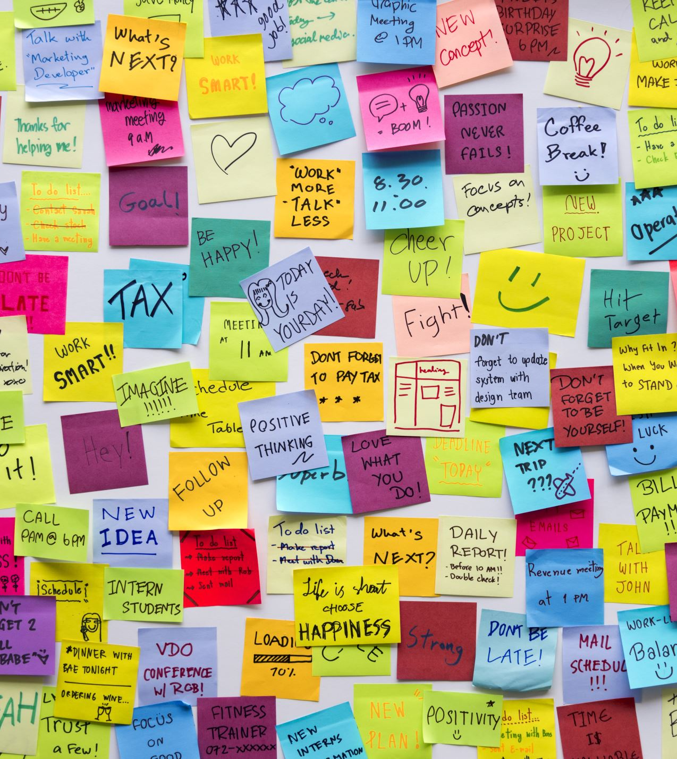
Today’s Plan
Writing stories to teach STEM concepts
Analysing stories to identify the main features
Workshop on writing a story
Peer-reviewing the stories
Presenting the stories

Slide 3
LITERARY ASPECTS

Slide 4
Why Stories Enhance STEM Learning
Contextualisation
Stories provide a context for STEM concepts, making them easier to understand and remember.
Engagement
Stories capture students' attention and can motivate them to explore further into STEM subjects.
Creativity
Stories can engage students creatively by encouraging them to harness imagination and critical thinking skills to solve STEM-related challenges.
Inspiration
STEM stories can inspire students to pursue a future in STEM fields by showcasing the potential practical and exciting applications of STEM knowledge.

Slide 5
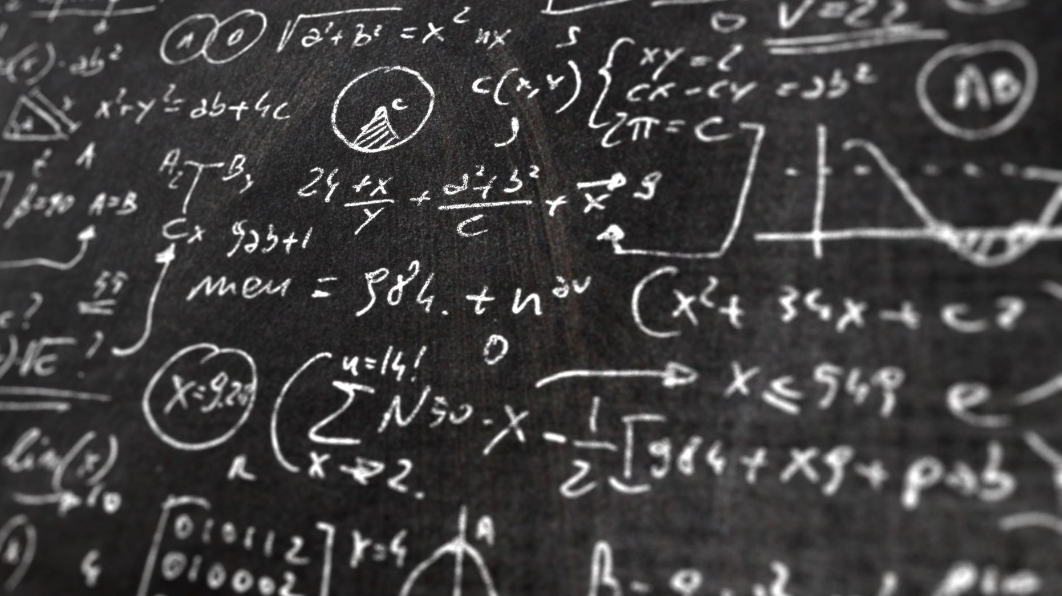
Basic elements of short story or fiction
Authors create narratives using different elements of fiction. Among their most important resources are plot, the sequence of related events composing the narrative, and characters, the persons who play their parts in the narrative. The author’s choice of setting, the place and time in which the action occurs, helps to give the story verisimilitude. The point of view establishes a consistent perspective on the characters and their actions as the narrative unfolds. The author’s literary style, the way he or she uses the multifarious resources of language, also shapes the expression of a story. Finally, the author is guided by his or her perception of theme, the unifying idea that brings to life all the other elements of fiction. (Charters 2)

Slide 6
A few steps to follow
Choose the concept
Identify the learning objectives
Create engaging characters
Context and setting
Draft a compelling plot
Use Analogies and Metaphors
Engaging dialogue
Storytelling techniques
Promote Critical Thinking

Slide 7
Literary terms to be used while writing a story

Slide 8
Imagery
Imagery is a literary term that involves creating vivid mental pictures using descriptive language.

Slide 9
Visual Imagery:
appeals to the sense of sight and helps readers visualize scenes.
"The bright, yellow sun shone in the clear, blue sky."
"The forest was full of tall, green trees."
For higher levels:
"The sun dipped below the horizon, painting the sky with hues of orange and pink."
"The forest was a sea of emerald, with tall trees forming a dense, dark canopy overhead."

Slide 10
Auditory Imagery:
appeals to the sense of hearing, allowing readers to "hear" the sounds described.
"The birds sang sweetly in the morning, filling the air with music."
"The thunder rumbled loudly during the storm."
For higher levels:
"The waves crashed against the shore, their rhythmic roar soothing the beachgoers."
"The wind whispered through the leaves, creating a gentle, melodic rustling."

Slide 11
Tactile Imagery:
engages the sense of touch and describes how things feel.
“The soft kitten’s fur felt warm and fuzzy.”
“The cold snowflakes melted on my skin.”

Slide 12
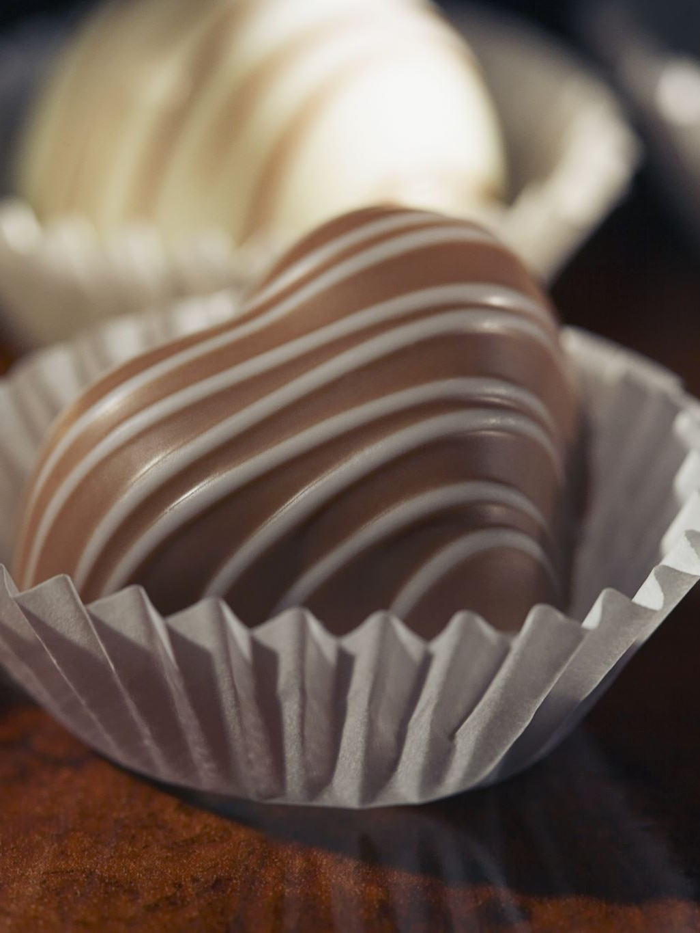
Gustatory Imagery:
relates to the sense of taste, helping readers imagine flavours.
“The sweet taste of chocolate melted in my mouth.”
“The soup was salty and warm.”

Slide 13
Olfactory Imagery:
appeals to the sense of smell, evoking scents and odours.
“The fresh flowers in the garden smelled so sweet.”
“The pizza’s aroma wafted from the oven, making me hungry.”

Slide 14
Let’s see the effect
A boy was walking on the street.
=> A boy was walking on the sunlit street.
=> A boy was walking on the lively and sunlit street.
=> A boy with brown hair was walking on the lively and sunlit street.
= > A boy with brown hair was energetically walking on the lively and sunlit street.

Slide 15
Personification
Personification is a literary device that gives human qualities and characteristics to non-human entities or objects.

Slide 16
Examples:
The wind whispered through the trees.
The sun smiled down on the beachgoers.
The car's engine coughed and sputtered before finally starting.
The leaves danced in the breeze.
The old house groaned as if it were tired.
The river sang a soothing lullaby as it flowed gently.
The moon watched over the city with a silver glow.
The storm angrily lashed out with lightning and thunder.

Slide 17
Simile
Simile is a literary device that compares two unlike things using "like" or "as" to create a vivid and descriptive image.

Slide 18
Examples:
Her smile was as bright as the sun.
The water in the lake was as clear as crystal.
He fought like a lion on the battlefield.
Her hair was as black as midnight.
The car roared down the highway like a thunderstorm.
The old man's voice trembled like a leaf in the wind.
The teacher's patience was as endless as the ocean.
Her laughter rang out like a bell in the quiet room.

Slide 19
Example
When she entered the room, she saw a screen.
=> When she entered the dark room, she saw a rectangular object.
=> When she entered the dark room, she saw a rectangular object and this object is like a screen.
=> When she entered the brown-coloured strange room, she shockingly realised a rectangular object that looks like a wide tele-screen.
=> When she entered the brown-coloured strange room, she shockingly realised a rectangular object that looks like a wide tele-screen. The object looked at her.

Slide 20
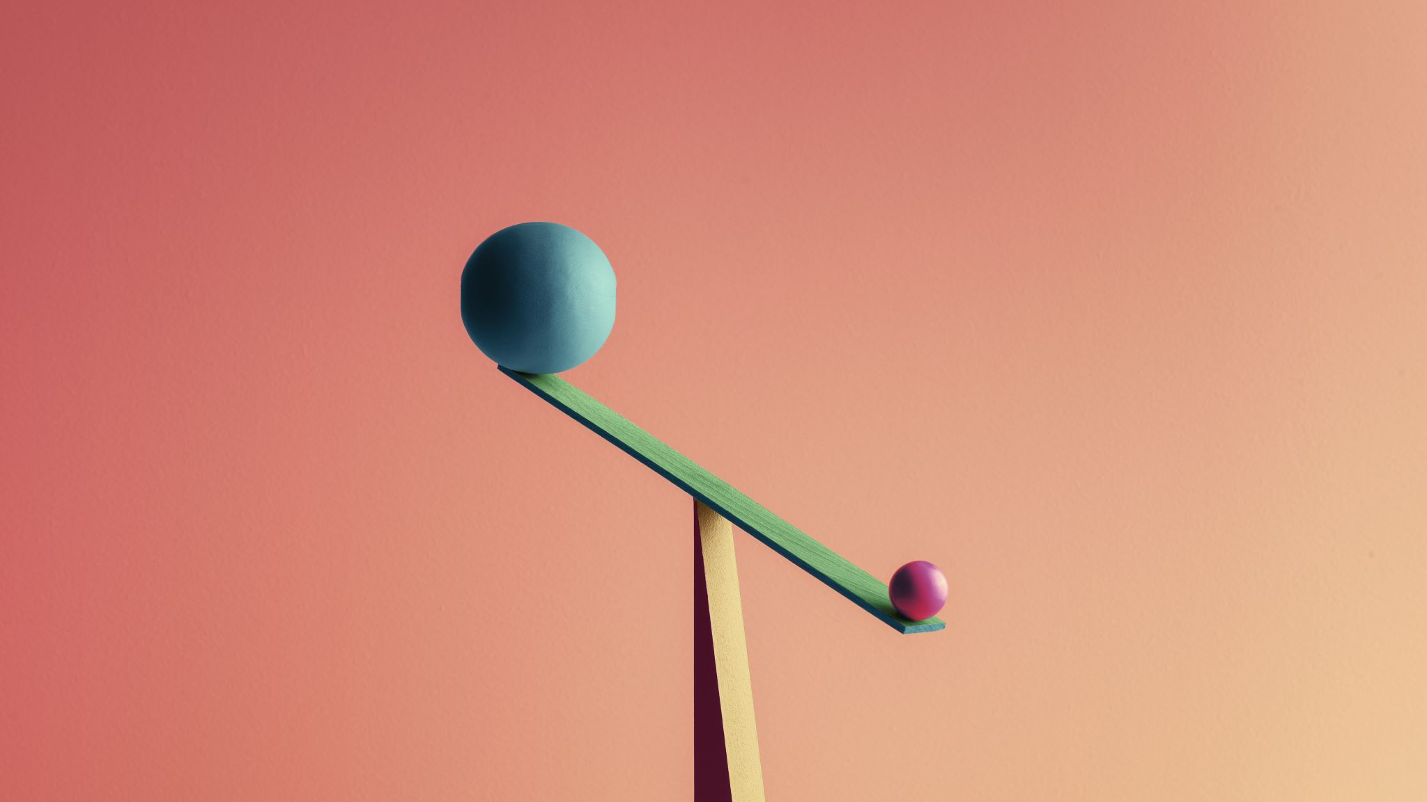
Metaphor
Metaphor is a literary device that makes a direct comparison between two unrelated things, suggesting that they are alike in some way without using "like" or "as."

Slide 21
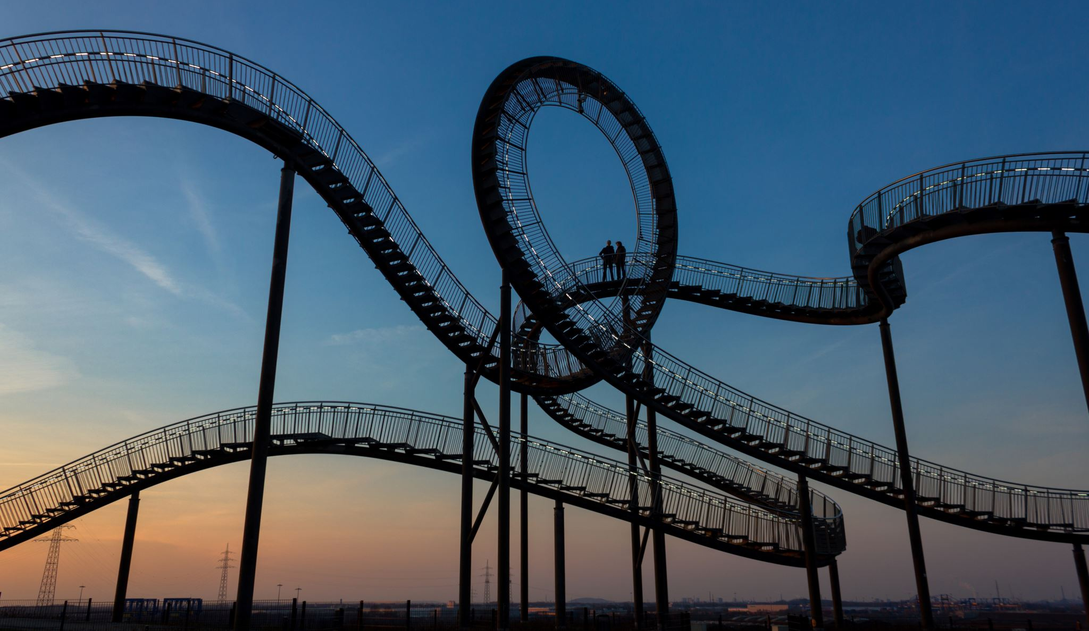
Examples:
Her heart is a fortress.
The world is a stage.
Time is money.
Life is a rollercoaster with its ups and downs.
The classroom was a zoo today.
Her smile is a ray of sunshine.

Slide 22
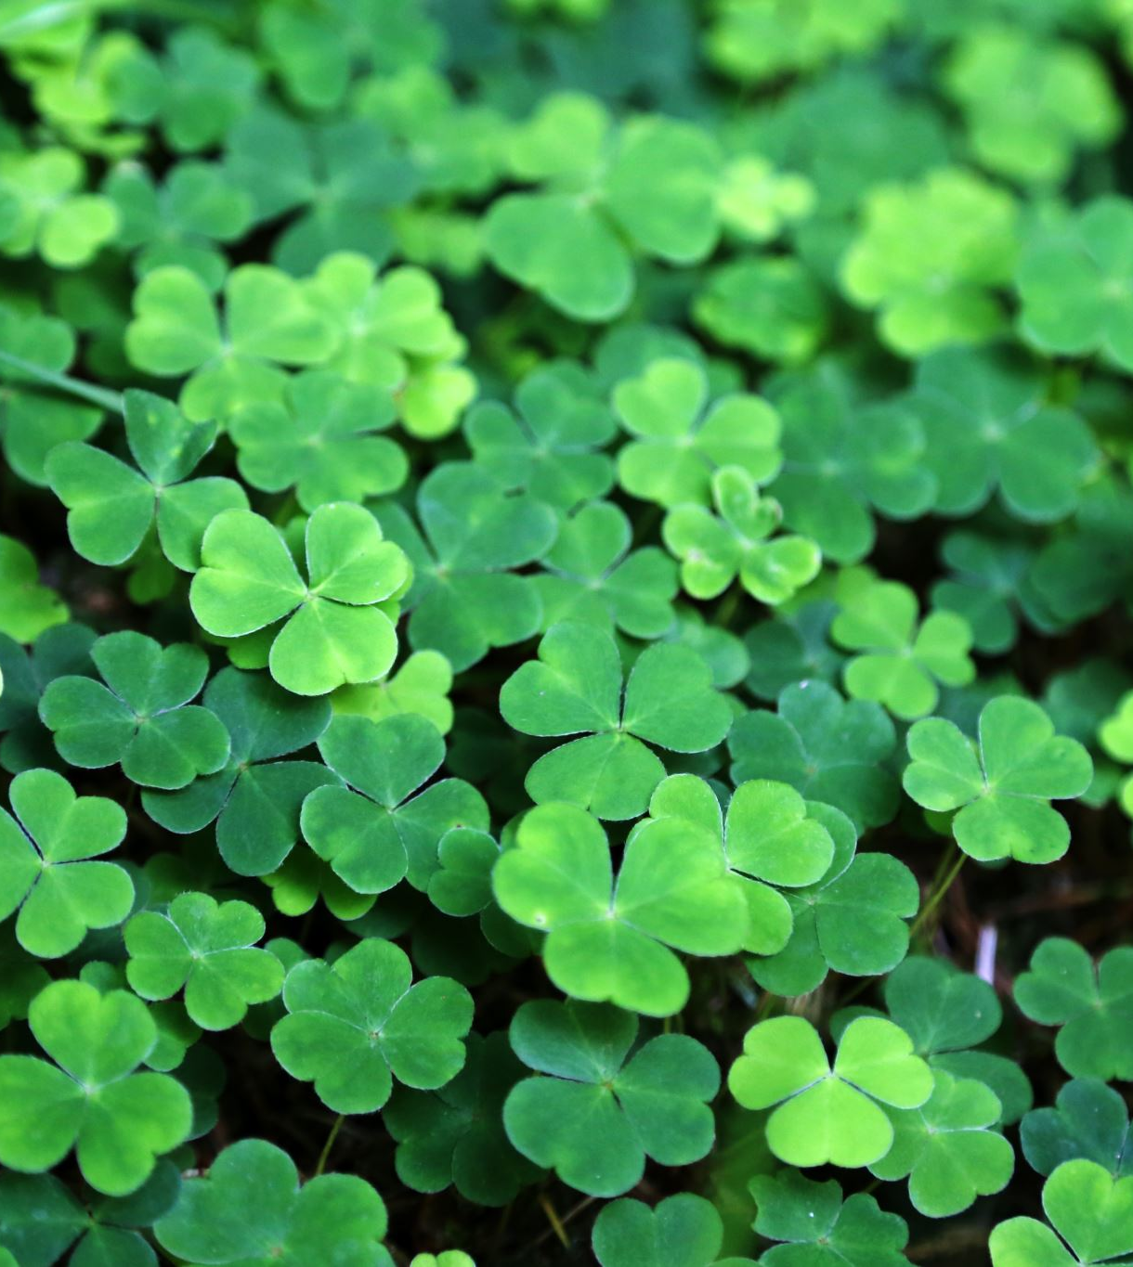
Alliteration
The repetition of consonant sounds at the beginning of words in close proximity.
Examples:
"Peter Piper picked a peck of pickled peppers."
“She sells seashells by the seashore.”
“Go and gather the green leaves on the grass.”

Slide 23
Irony
A contrast between expectation and reality, often used to create humour, surprise, or a deeper meaning. Types of irony include verbal, situational, and dramatic irony.
Verbal Irony:
When someone says, "Oh, great! Another rainy day!" on a day filled with sunshine and clear skies.
Dramatic Irony:
In Shakespeare's "Romeo and Juliet," the audience knows that Juliet is not truly dead, but Romeo, who thinks she is, takes his own life beside her.
Situational Irony:
A fire station burns down during a massive firefighting drill.
A lifeguard drowns while trying to save a swimmer.

Slide 24
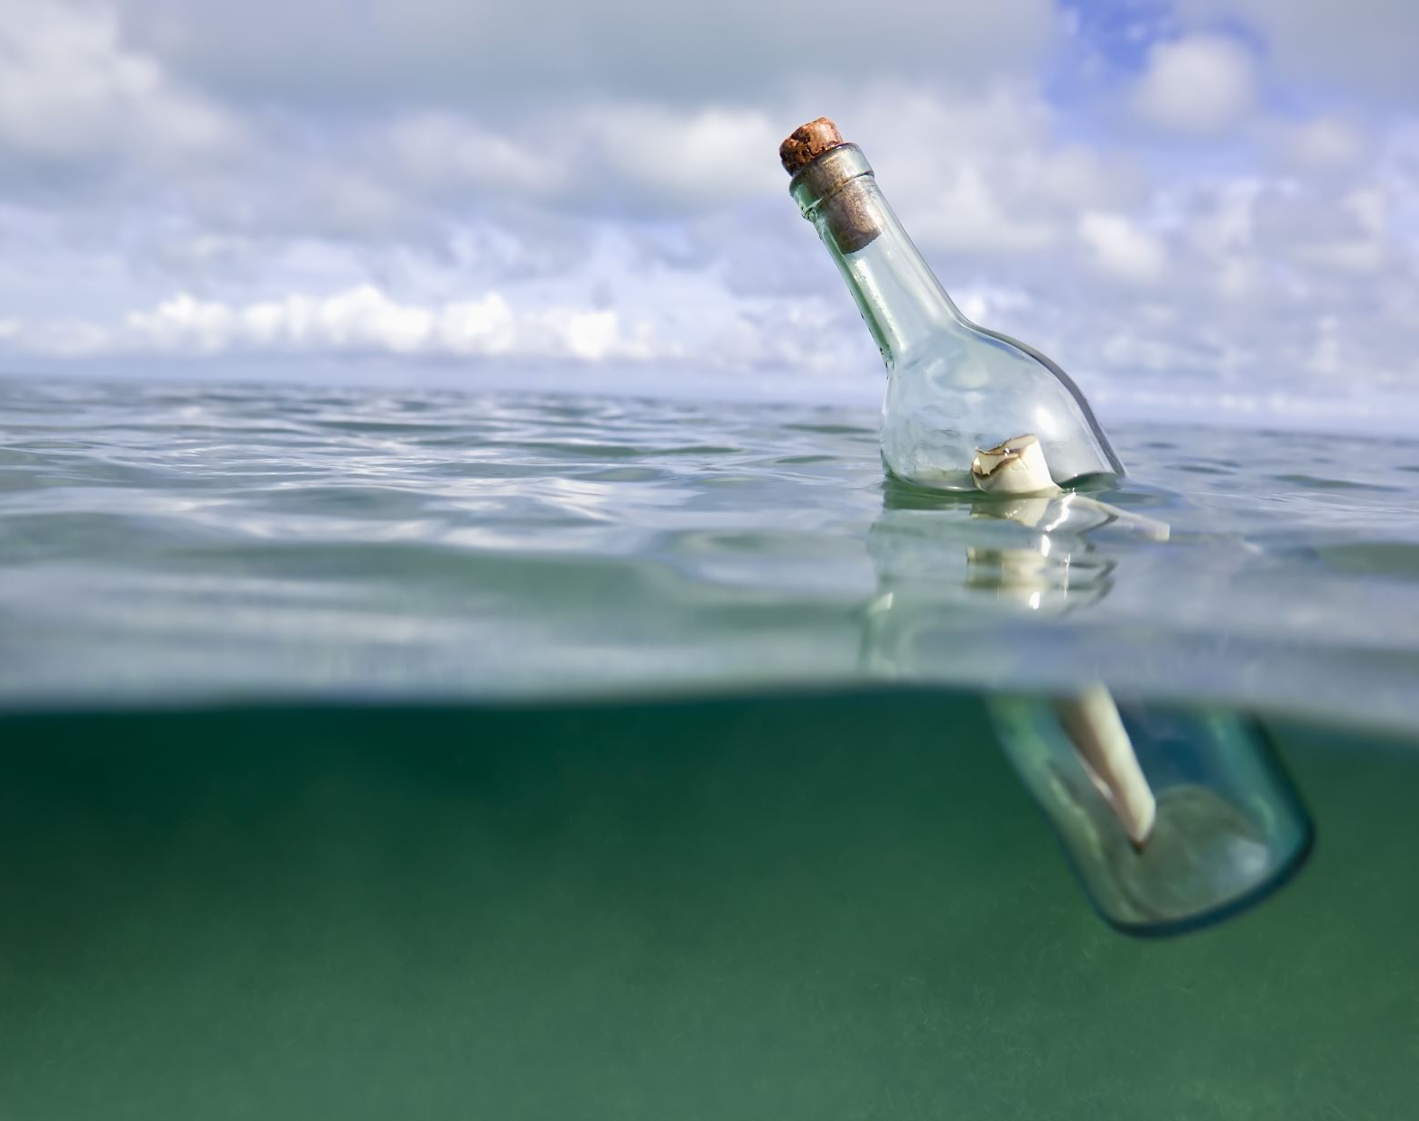
Allegory
A story, poem, or picture that can be interpreted to reveal a hidden meaning, typically a moral or political one. For example, George Orwell's Animal Farm is an allegory for the Russian Revolution.
«The Cave Allegory» by Plato - In this philosophical allegory, prisoners in a cave represent people who are ignorant of the true reality, mistaking shadows on the wall for actual objects.

Slide 25
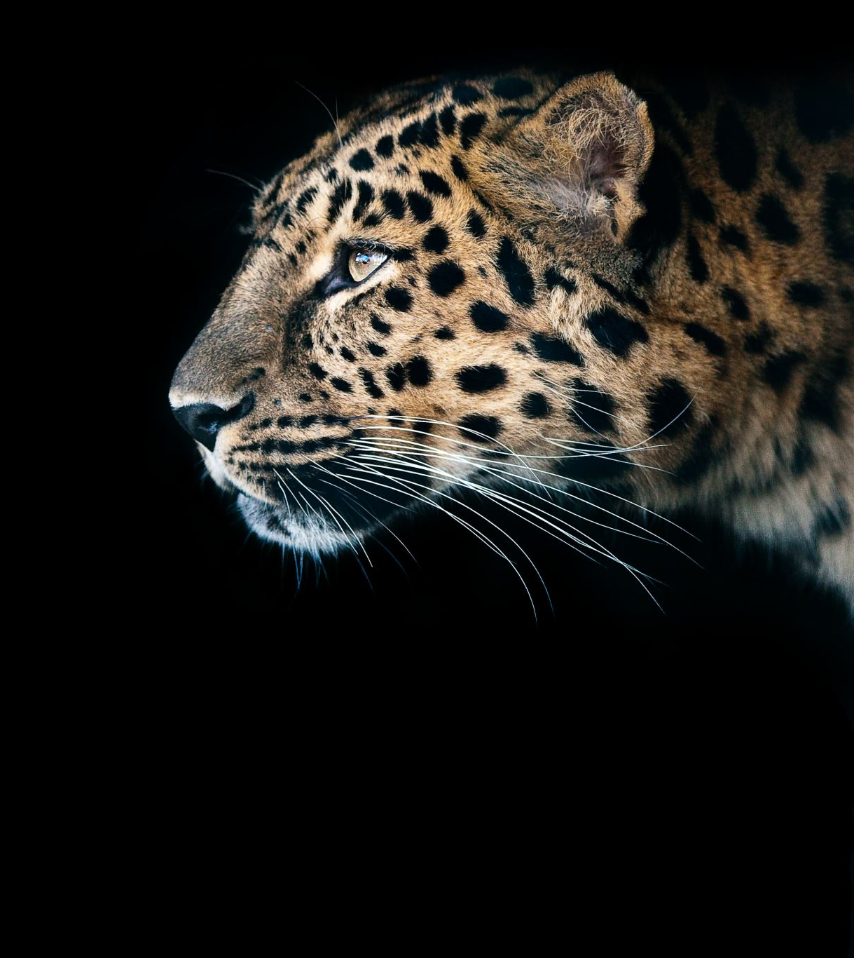
Hyperbole
Exaggerated statements or claims used for emphasis or to create a humorous effect. For instance, "I'm so hungry I could eat a horse.»
This bag weighs a ton.
She’s a million years old.
I’ve told you a thousand times.
I’m dying of embarrassment.
He’s as tall as a mountain.

Slide 26
Oxymoron
A figure of speech that combines contradictory terms, like "bittersweet" or "jumbo shrimp."
-My sister and I had a friendly fight.
-Santana left the painting completely unfinished.
Deafening silence / the sound of silence / bitter sweet / living dead / act naturally / open secret / seriously funny / pretty ugly

Slide 27
How to Produce an Intriguing and Creative Story and Learn

Slide 28
Draft a compelling plot:
Brainstorming
Draw the setting
Create unique characters
Raise the tension with a conflict
Resolution

Slide 31
Freytag’s Pyramid
Elements of dramatic structure in Freytag’s Pyramid:
Exposition: The storyteller sets the scene and the character’s background.
Inciting Incident: The character reacts to something that has happened, and it starts a chain reaction of events.
Rising Action: The story builds. There is often a complication, which means the problem the character tried to solve gets more complex.
Climax: The story reaches the point of greatest tension between the protagonist and antagonist (or if there is only one main character, the darkness or lightness of that character appears to take control).
Falling Action: The story shifts to action that happens as a result of the climax, which can also contain a reversal (when the character shows how they are changed by the events of the climax).
Resolution: The character solves the problem or conflict.
Denouement: French for “the ending,” the denouement is often happy if it’s a comedy, and dark and sad if it’s a tragedy.
Source: https://www.clearvoice.com/resources/what-is-freytags-pyramid-dramatic-structure/

Slide 32
Source: https://thejohnfox.com/2021/01/9-story-structures-to-plot-your-next-novel/

Slide 33
«Story Structure: 11 Narrative Structure Tools to Build Your Plot» by Jason Hamilton
The Fichtean Curve
The Three Act Structure
The Hero's Journey
Freytag's Pyramid
The Five Act Structure
Save the Cat Beats
The Snowflake Method
Dan Harmon's Story Circle
The Seven Point Story Structure
The Story Spine
In Media Res
Source: https://kindlepreneur.com/story-structure/

Slide 34
SETTING / EXPOSITION

Slide 35
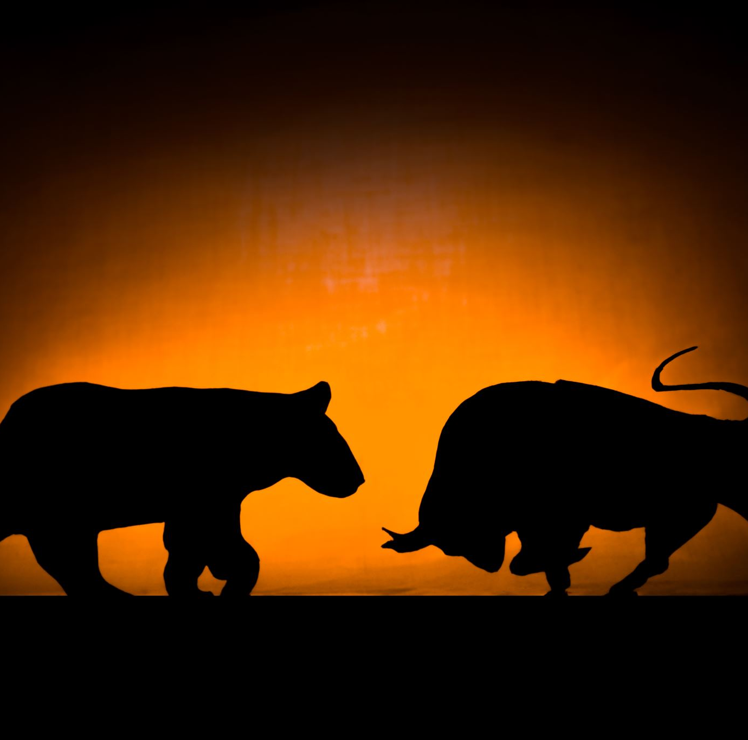
Exposition ________________________________________________ «A Sound of Thunder» by Ray Bradbury
The sign on the wall seemed to quaver under a film of sliding warm water. Eckels felt his eyelids blink over his stare, and the sign burned in this momentary darkness:
TIME SAFARI, INC.
SAFARIS TO ANY YEAR IN THE PAST.
YOU NAME THE ANIMAL.
WE TAKE YOU THERE.
YOU SHOOT IT.

Slide 36
Exposition ___________________________________________ «The Machine Stops» (1909) by E. M. Forster
The Air-Ship
Imagine, if you can, a small room, hexagonal in shape, like the cell of a bee. It is lighted neither by window nor by lamp, yet it is filled with a soft radiance. There are no apertures for ventilation, yet the air is fresh. There are no musical instruments, and yet, at the moment that my meditation opens, this room is throbbing with melodious sounds. An armchair is in the centre, by its side a reading-desk — that is all the furniture. And in the armchair there sits a swaddled lump of flesh — a woman, about five feet high, with a face as white as a fungus. It is to her that the little room belongs.

Slide 37
Exposition __________________________________ Brave New World (1932) by Aldous Huxley
A SQUAT grey building of only thirty-four stories. Over the main entrance the words, CENTRAL LONDON HATCHERY AND CONDITIONING CENTRE, and, in a shield, the World State's motto, COMMUNITY, IDENTITY, STABILITY.
The enormous room on the ground floor faced towards the north. Cold for all the summer beyond the panes, for all the tropical heat of the room itself, a harsh thin light glared through the windows, hungrily seeking some draped lay figure, some pallid shape of academic goose-flesh, but finding only the glass and nickel and bleakly shining porcelain of a laboratory. Wintriness responded to wintriness. The overalls of the workers were white, their hands gloved with a pale corpse-coloured rubber. The light was frozen, dead, a ghost. Only from the yellow barrels of the microscopes did it borrow a certain rich and living substance, lying along the polished tubes like butter, streak after luscious streak in long recession down the work tables.

Slide 38
CONFLICT

Slide 39
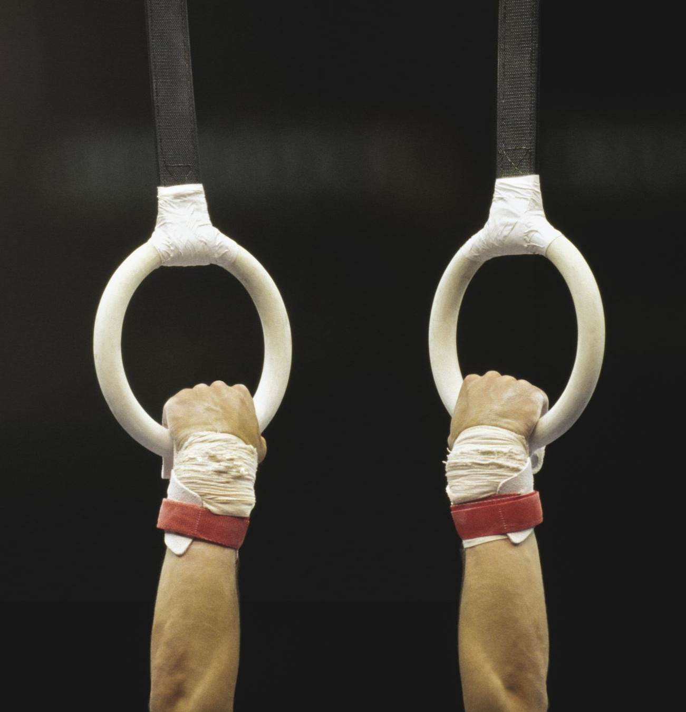
Types of Conflicts
Man vs. Man – a conflict between people or animals
Man vs. Himself – a psychological battle within a character’s own mind
Man vs. Nature – a struggle against the elements for survival
Man vs. Society – a fight for justice often against the government
Man vs. The Supernatural – a battle with a non-physical entity or god-like figure
Man vs. Technology – a relatively new conflict that explores the ways in which technology may “turn against us”

Slide 40
Example: external conflict
The girl and her mother are standing.
=> The girl and her mother are standing and looking at each other angrily.
=> The girl and her mother are standing and looking at each other angrily. The girl does not want to go shopping with her mother.
=> The girl and her mother are standing and looking at each other angrily. The girl does not want to go shopping with her mother. The mother does not want her daughter to go to the cinema with her friends.

Slide 41
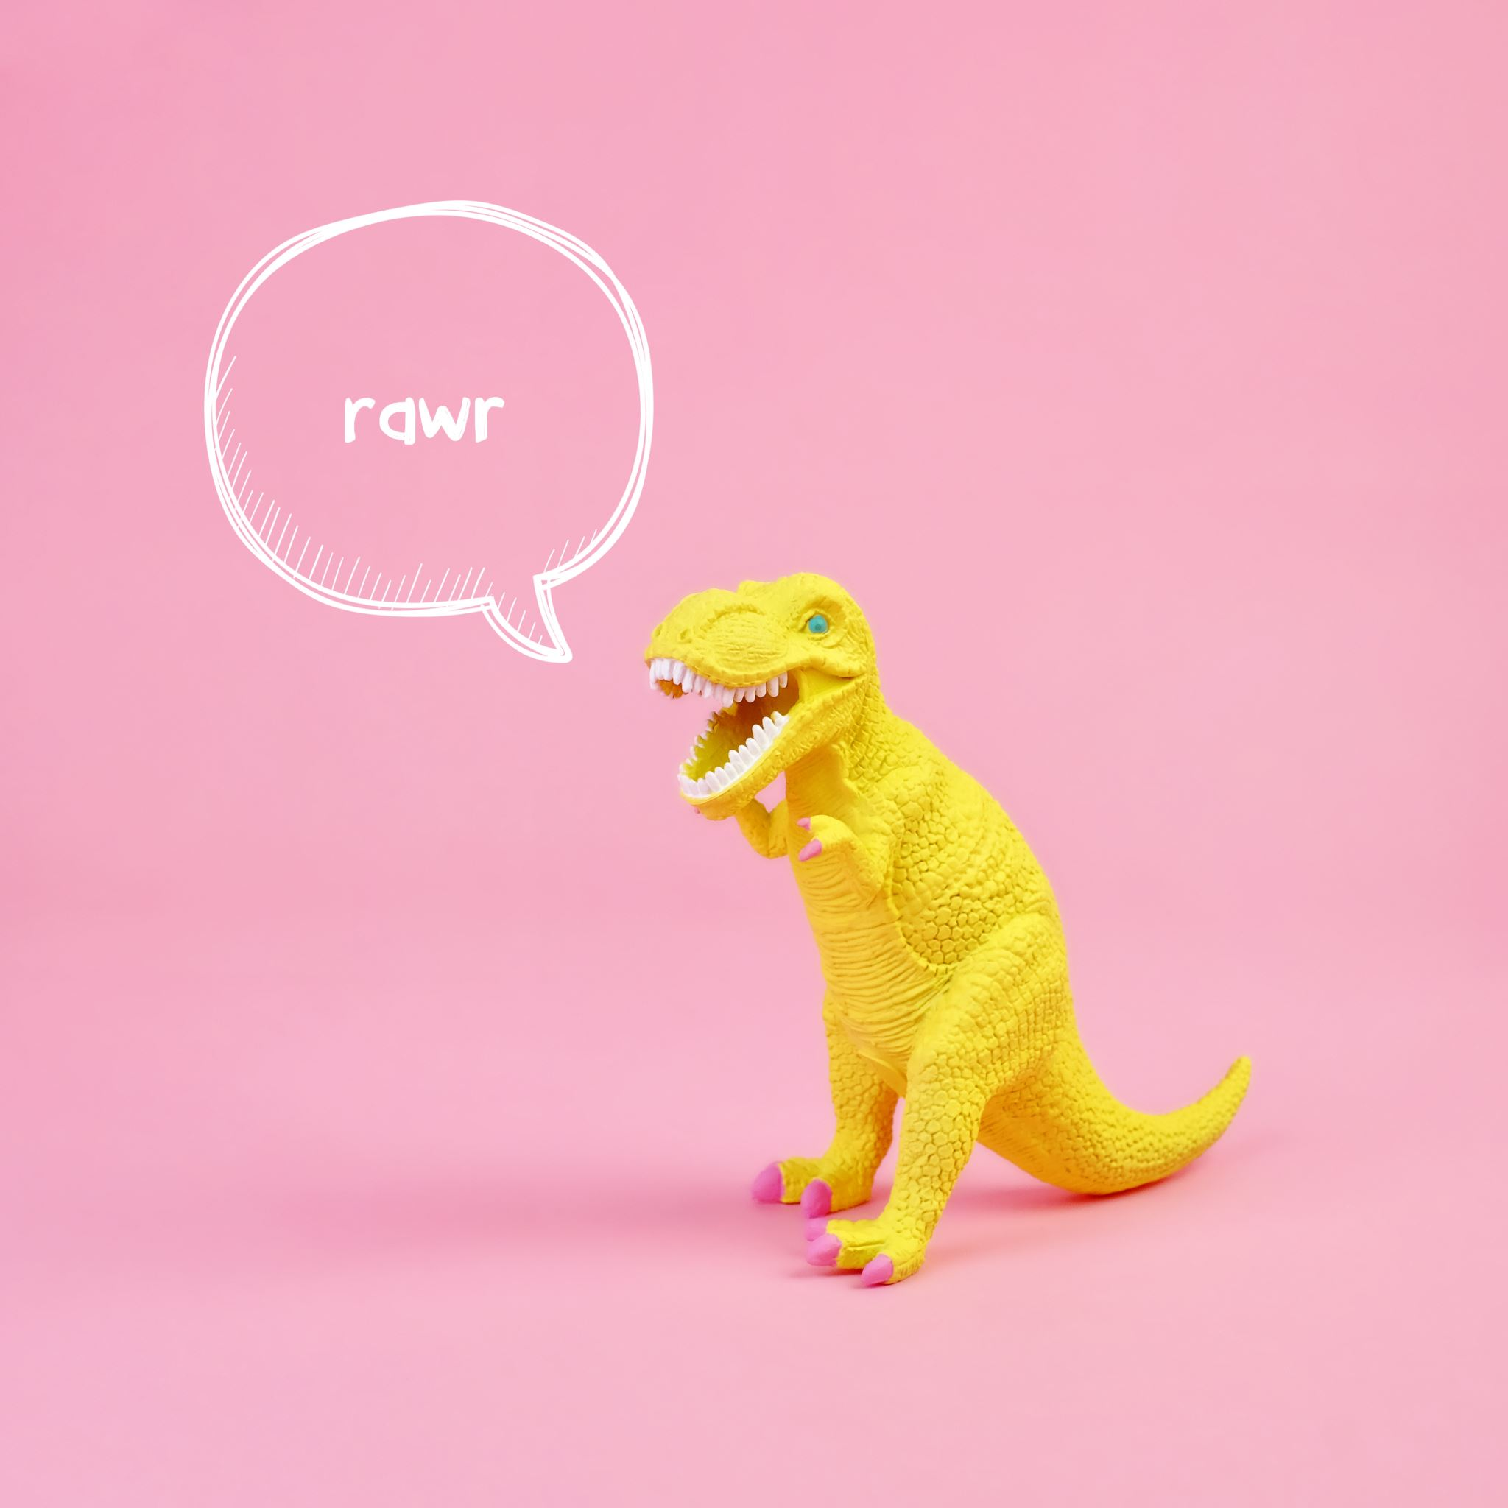
The Story: “A Sound of Thunder” by Ray Bradbury (shortened and simplified)

Slide 42
The year is 2055, there is a time travel company. Its name is Time Safari. there was a man named Eckels. He wanted to travel back in time to see dinosaurs. He went to a special time travel company. They had a guide named Travis. Travis warned Eckels to follow the rules. He said, "Stay on the path. Don't touch anything. Don't change anything.”
Eckels and two others got in a time machine. They travelled to the past, to the time of the dinosaurs. It was scary and exciting. Eckels saw a big, scary dinosaur, T-Rex. He got scared and stepped off the path. He didn’t realize but stepped on a butterfly. Then they went back to the present.
When they got back, everything was different. Words and people were strange. Eckels had changed the past by stepping on the butterfly. There was a different sign on the wall, and Travis looked different too. Travis was very angry and punished Eckels. The past had changed more than they thought. The past changed, and the present changed, everything changed with just one butterfly and one mistake.

Slide 43
The year is 2055, there is a time travel company. Its name is Time Safari. there was a man named Eckels. He wanted to travel back in time to see dinosaurs. He went to a special time travel company. They had a guide named Travis. Travis warned Eckels to follow the rules. He said, "Stay on the path. Don't touch anything. Don't change anything.”

Slide 44
Eckels and two others got in a time machine. They travelled to the past, to the time of the dinosaurs. It was scary and exciting. Eckels saw a big, scary dinosaur, T-Rex. He got scared and stepped off the path. He didn’t realize but stepped on a butterfly. Then they went back to the present.

Slide 45
When they got back, everything was different. Words and people were strange. Eckels had changed the past by stepping on the butterfly. There was a different sign on the wall, and Travis looked different too. Travis was very angry and punished Eckels. The past had changed more than they thought. The past changed, and the present changed, everything changed with just one butterfly and one mistake.

Slide 46
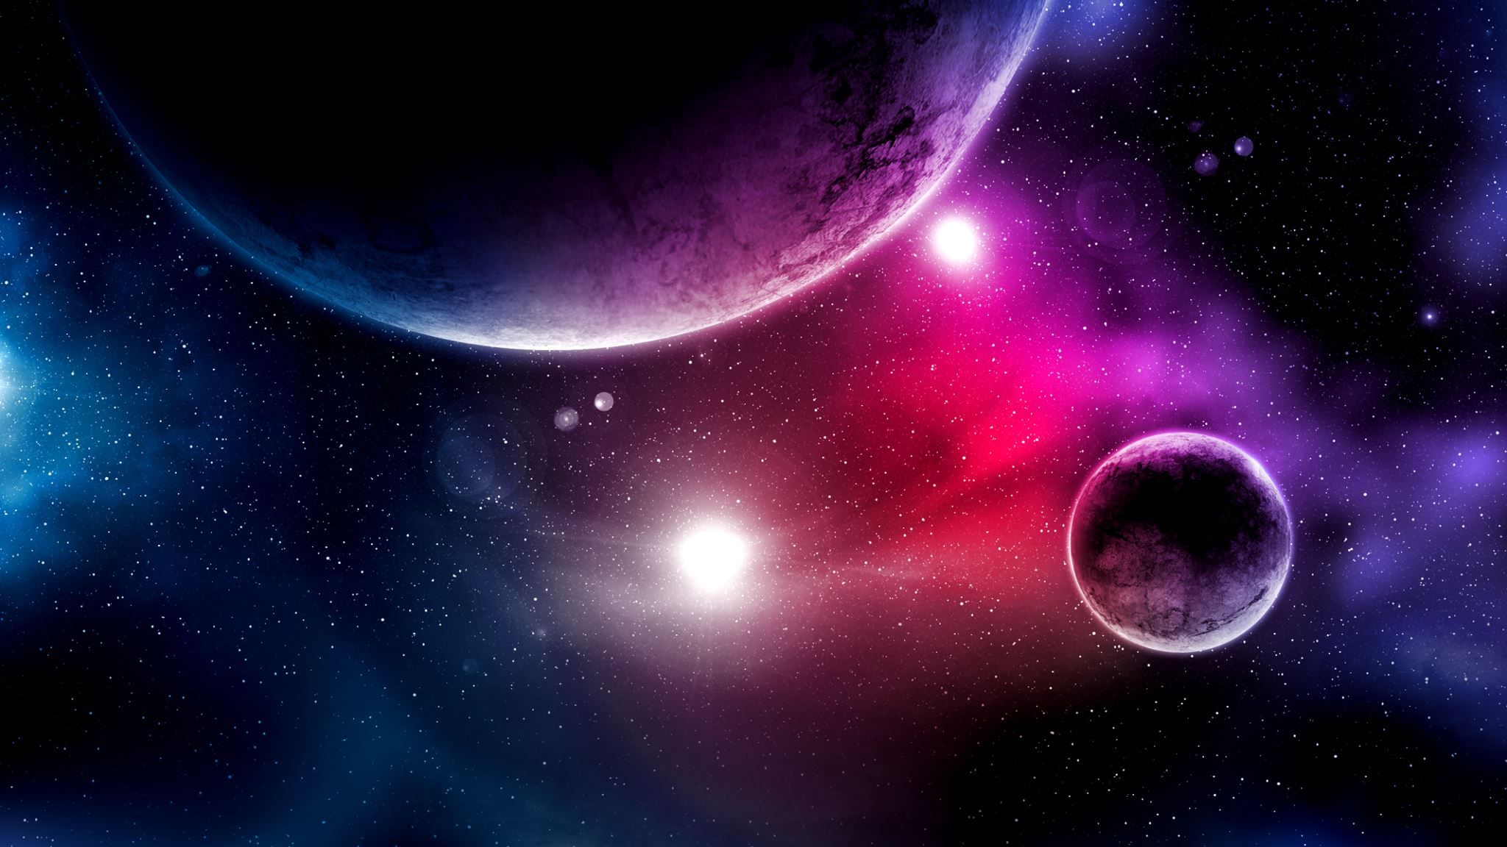
Let’s imagine…
Writing a story is a combination of questions

Slide 47
What if…
What if gravity suddenly stopped working for one person?
What if a single painting had the power to change reality?
What if dreams were portals to parallel universes?
What if a time-traveling tourist accidentally altered the course of history?
What if an AI developed emotions and self-awareness?
What if people could trade memories like commodities?
What if humanity discovered a way to access the collective knowledge of the universe through a single portal?
What if humanity had to live underwater due to a catastrophic event on land?
What if everyone's emotions were visible as colourful auras around them?

Slide 48
Creative Prompts to be Developed into Stories

Slide 49
Creative Prompts to be Developed into Stories
The time-travel machine
The robotic pet rescuer
The Quantum Puzzle
The Code-Breaking Detective
The Renewable Energy Revolution:
The Microscopic Adventure
The Inventor's Notebook
The Robot Revolution

Slide 50
Let’s imagine…
planets, asteroid, meteor shower

Slide 51
A few questions…
How am I going to tell that story?
Who is the main character (the protagonist)?
Who / What is this story about?
What does this character want or try to do?
What is the obstacle?
What do this character do to overcome the obstacles?
How does it end?

Slide 52
Let’s imagine…
After choosing the general topic and the situation, who are the characters?
Where does the story happen? When does it happen?
What is the problem? Is there a problem to be solved?
What kind of a conflict is there in the story? Man vs. man? Man vs. External force? Internal conflict? Man vs. technology?

Slide 53
Let’s imagine…
Let’s imagine that you are a scientist and looking through a microscope to analyse a leaf. But, what you see is a human being on this leaf. You cannot believe in your eyes. And….
Let’s imagine that a bug enters to our biology class and starts to talk to us, and asks to join us while we are talking about the insects which includes its ancestors, relatives, etc.

Slide 54
Age and Language Level Appropriacy in Stories
Common European Framework of Reference / Descriptors for Reading and Writing Skills
Reading and Writing Skills at A1.1 Level (Beginner Level):
Reading: Can understand and read simple, short texts with familiar vocabulary and basic sentence structures. Can recognize common words and phrases related to everyday life.
Writing: Can write basic words, phrases, and simple sentences. Can complete forms with personal information and write short messages or notes.
Reading and Writing Skills at A1.2 Level (Basic Level - Elementary Proficiency):
Reading: Can understand short texts on familiar topics. Can grasp the main idea and extract basic information from texts. Recognizes frequently used expressions and simple sentences.
Writing: Can write short paragraphs or descriptions on familiar topics. Can compose simple personal letters, emails, or messages. Can fill out forms and write simple sentences to describe routine activities.
Reading and Writing Skills at A2 Level (Basic Level):
Reading: Can understand simple texts on various subjects, including personal interests. Can comprehend the main ideas and extract relevant details. Can understand everyday signs and notices.
Writing: Can write coherent and connected texts about familiar topics. Can compose short essays, stories, or descriptions. Can write emails or letters conveying simple messages and information. Can summarize short texts.

Slide 55
Thank you
Emine ŞENTÜRK

